Slide 1





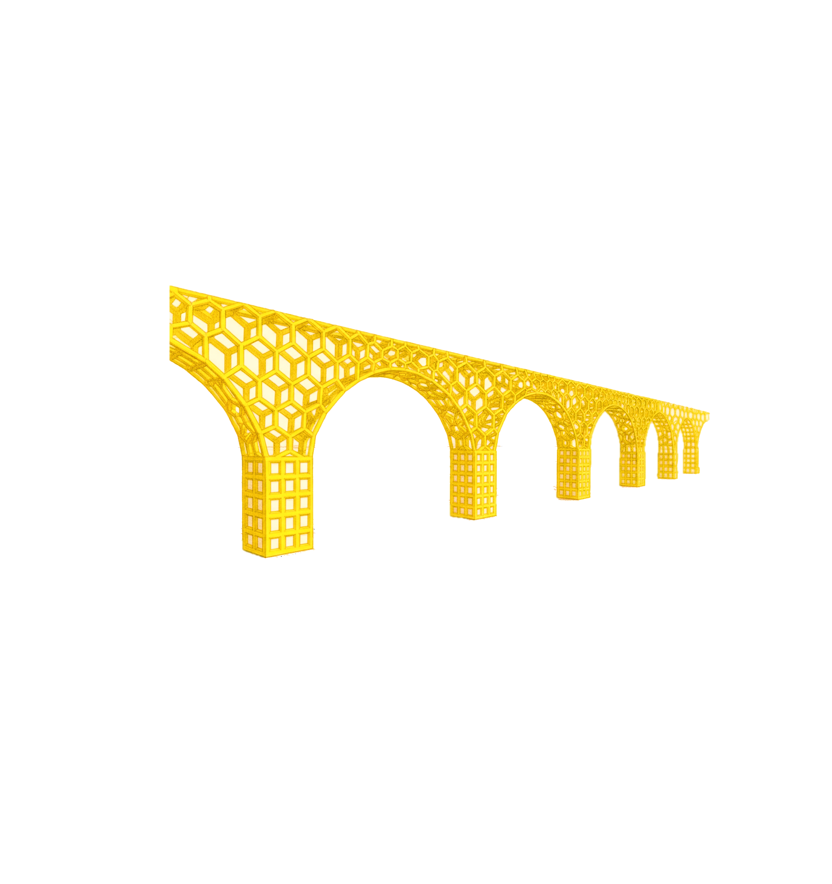



Poster Title (Title: Times New Roman, size 40, center and bold)
Author Name,ª Author Name, ⃰ ^{b} Author Name, ^{c} …. (Times New Roman, size 30, center and bold)
ªDepartment of … (Times New Roman, size 28, center and bold)
Corresponding Author’s E-mail: … (Times New Roman, size 28, center)
ABSTRACT
REASEARCH PRESENTATION
RESULTS & DISCUSSION
Font: Times New Roman, Size:28, Line Spacing:1.0
Font: Times New Roman, Size:28, Line Spacing:1.0
INTRODUCTION
Font: Times New Roman, Size: 28, Line Spacing:1.0
EXPERIMENTAL
CONCLUSION
Font: Times New Roman, Size:28, Line Spacing:1.0
Font: Times New Roman, Size:28, Line Spacing:1.0
REFERENCES
[1] A. Name, B. Name and C. Name, Journal Title, 2017, 35, 3523
(Times New Roman 20)(Max 5 Refs)

